Slide 1

Dig245 final project
Jordan Reed

Slide 2
Final project proposal
My proposal for the final project will focus on the usability of a website. I want to create two designs that encapsulate what good and bad usability is and how it affects the user.

Slide 3
Definition of bad design
What I think would really show the user how bad a design can be I plan on incorporating the following.
Unappealing colors
Confusing organization
Dark Patterns
Pop ups
Misleading information/instructions
Etc.
Cluttered elements

Slide 4
Definition of good design
These following points is what I believe would convey good design and usability.
Well organized layout
Appealing color scheme
A minimalistic/modern look
Functional

Slide 5
User interaction
To incorporate user interaction I will ask the user to select the elements in both of the designs and they will become highlighted and ask for what they do or do not like about the elements.
When they are asked to put in what the did/didn’t like, I will probably have a drop down with prewritten options(positive/negative/neutral).

Slide 6
Preliminary design
The general design that I am considering, would be a three-four pages. The pages would be the following
Intro page
Bad design page
Good design page
Results page(undecided)

Slide 7
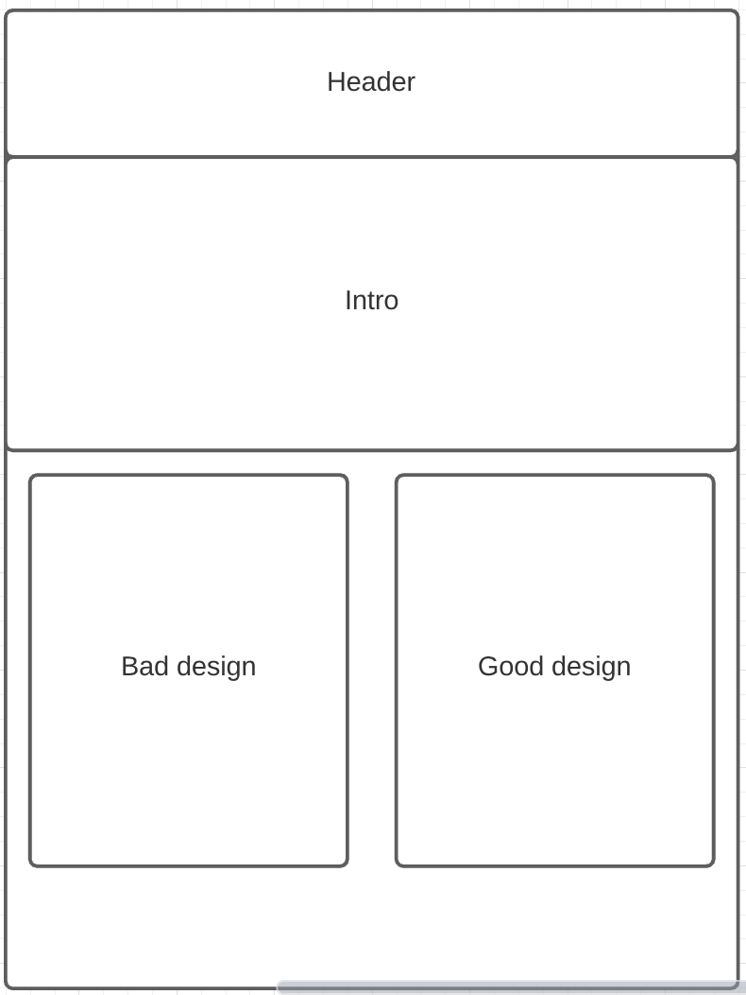
Introduction page

Slide 8
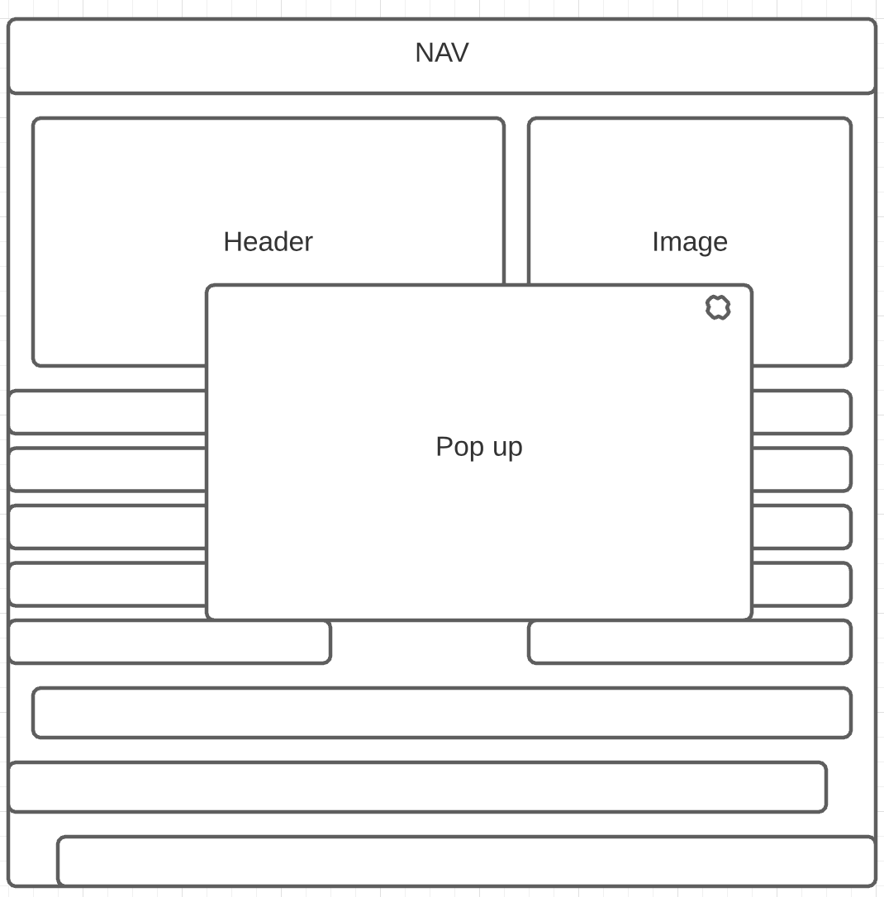
Bad design page

Slide 9
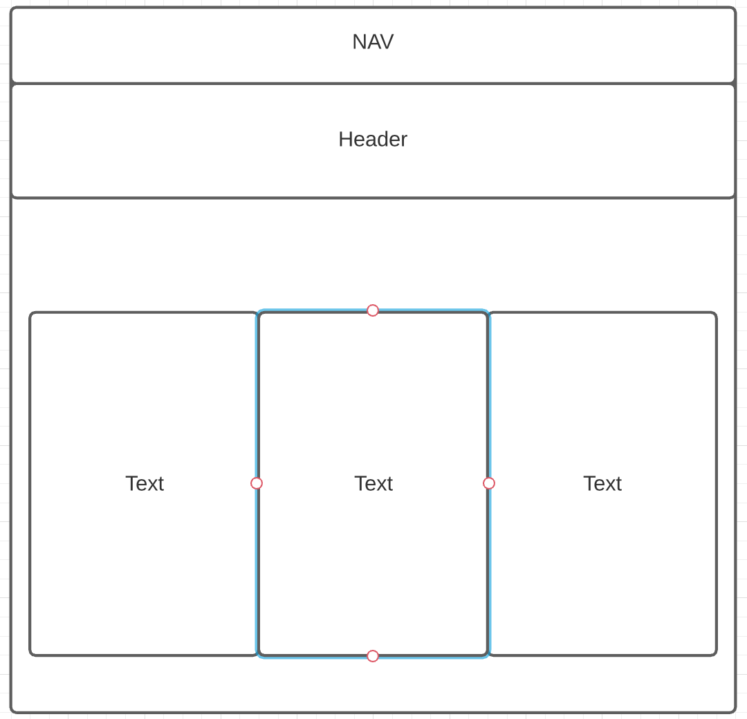
Good design page

Slide 10
Results page
Not sure on what this page will look like since I'm unsure how I will collect data.
complement

